Slide 1
Chapter 12 JavaFX GUI : Part 1

Slide 2
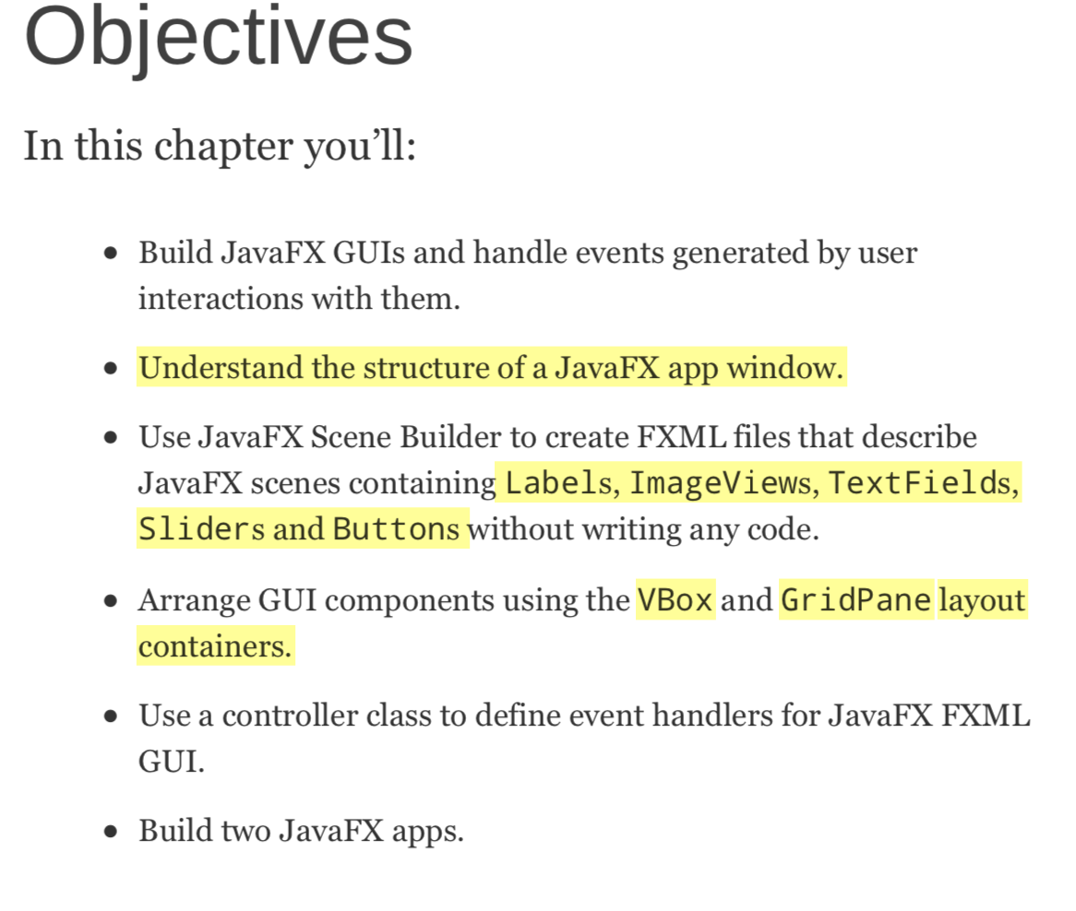

Slide 3
12.1 Introduction
History of GUI in Java
AWT(Abstract Window Toolkit ) was Java’s original GUI library
Swing was added to the platform in Java SE 1.2. Until recently, Swing was the primary Java GUI technology.
JavaFX is Java’s GUI, graphics and multimedia API of the future.

Slide 4
12.1 Introduction(Cont.)
Some of the benefits of JavaFX over Swing include:
JavaFX is easier to use.
look-and-feel via CSS.
better threading support
uses the GPU for hardware- accelerated rendering.
makes apps more intuitive and easier to use.
Could enhancing existing GUIs.
Notes:
Some of the benefits of JavaFX over Swing include:
JavaFX is easier to use, it includes GUI, graphics and multimedia (images, animation, audio and video).
JavaFX Scene Builder can produces the same code regardless of the IDE.
JavaFX gives you a JavaFX GUI’s look-and-feel via Cascading Style Sheets (CSS)—the same technology used to style web pages.
JavaFX has better threading support
JavaFX uses the GPU for hardware- accelerated rendering.
JavaFX supports transformations for repositioning and reorienting JavaFX components, and animations for changing the properties of JavaFX components over time.
JavaFX provides multiple upgrade paths for enhancing existing GUIs

Slide 5
12.2 JavaFX Scene Builder
The Scene Builder tool is a standalone JavaFX GUI visual layout tool that can also be used with various IDEs, including the most popular ones—Eclipse, IntelliJ IDEA and NetBeans. You can download Scene Builder at:
http://gluonhq.com/labs/scene-builder/

Slide 6
12.2 JavaFX Scene Builder(Cont.)
You can use Cascading Style Sheets (CSS) to change the entire look-and-feel of your GUI

Slide 7
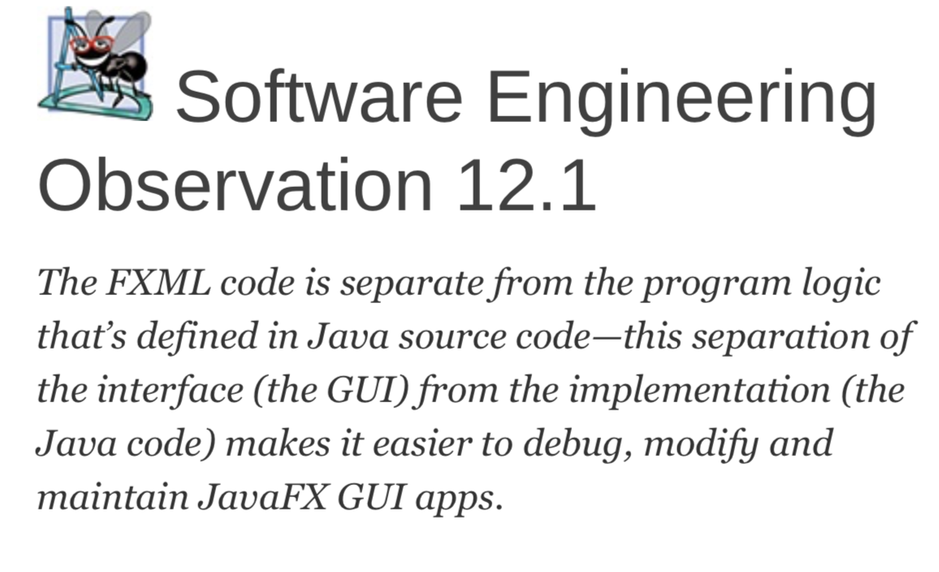

Slide 8
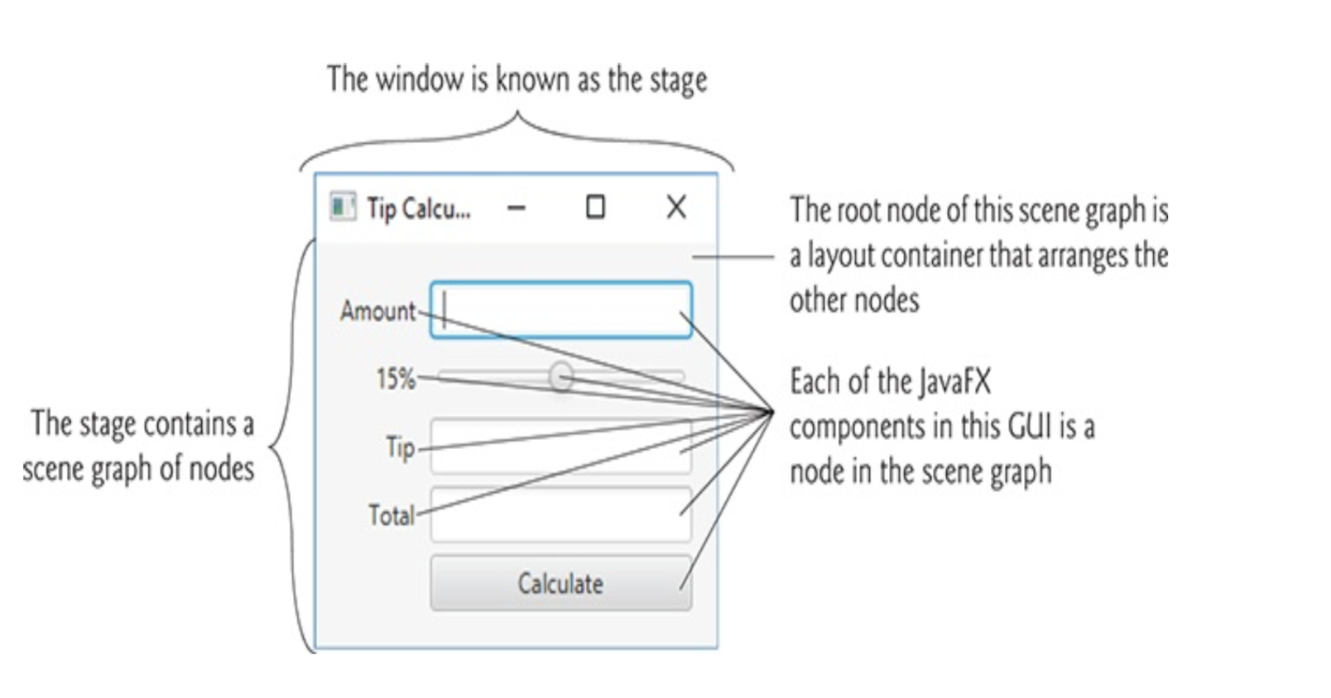
12.3 JavaFX App Window Structure

Slide 9
12.3 JavaFX App Window Structure(Cont.)
Controls
Controls are GUI components, such as Labels that display text, TextFields that enable a program to
receive user input, Buttons that users click to initiate actions, and more.
Stage
The window in which a JavaFX app’s GUI is displayed is known as the stage and is an instance of class Stage (package javafx.stage).
Scene
The stage contains one active scene that defines the GUI as a scene graph—a tree data structure of an app’s visual elements. The scene is an instance of class Scene (package javafx.scene).

Slide 10
12.3 JavaFX App Window Structure(Cont.)
Nodes
Each visual element in the scene graph is a node—an instance of a subclass of Node (package javafx.scene), which defines common attributes and behaviors for all nodes.
each node in the scene graph has one parent.
Nodes can have transforms (e.g., moving, rotating and scaling), opacity (whether a node is transparent, partially transparent or opaque), effects (e.g., drop shadows, blurs, reflection and lighting).

Slide 11
12.3 JavaFX App Window Structure(Cont.)
Layout Containers
Nodes that have children are typically layout containers that arrange their child nodes in the scene
Event Handler and Controller Class
An event handler is a method that responds to a user interaction.
An FXML GUI’s event handlers are defined in a so-called controller class

Slide 12
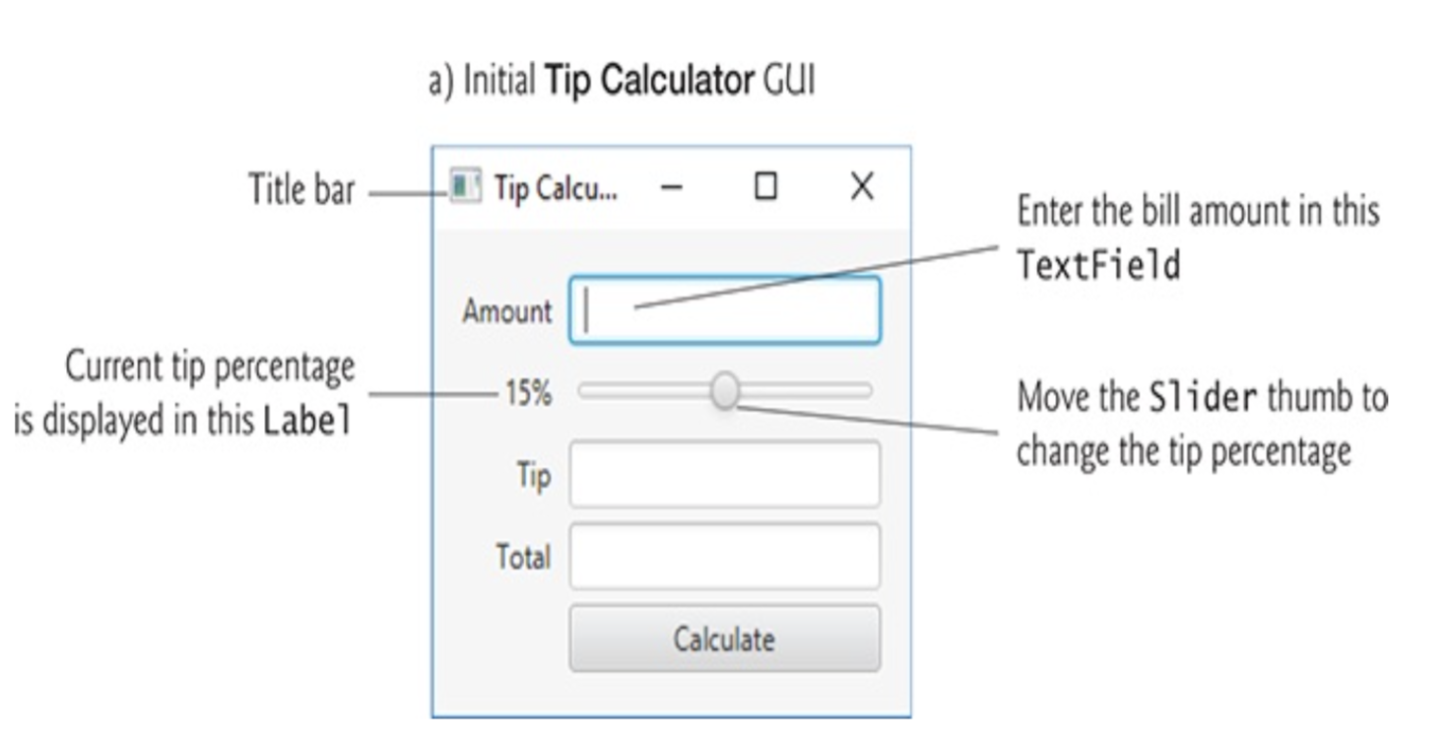
12.4 Tip Calculator App— Introduction to Event Handling

Slide 13
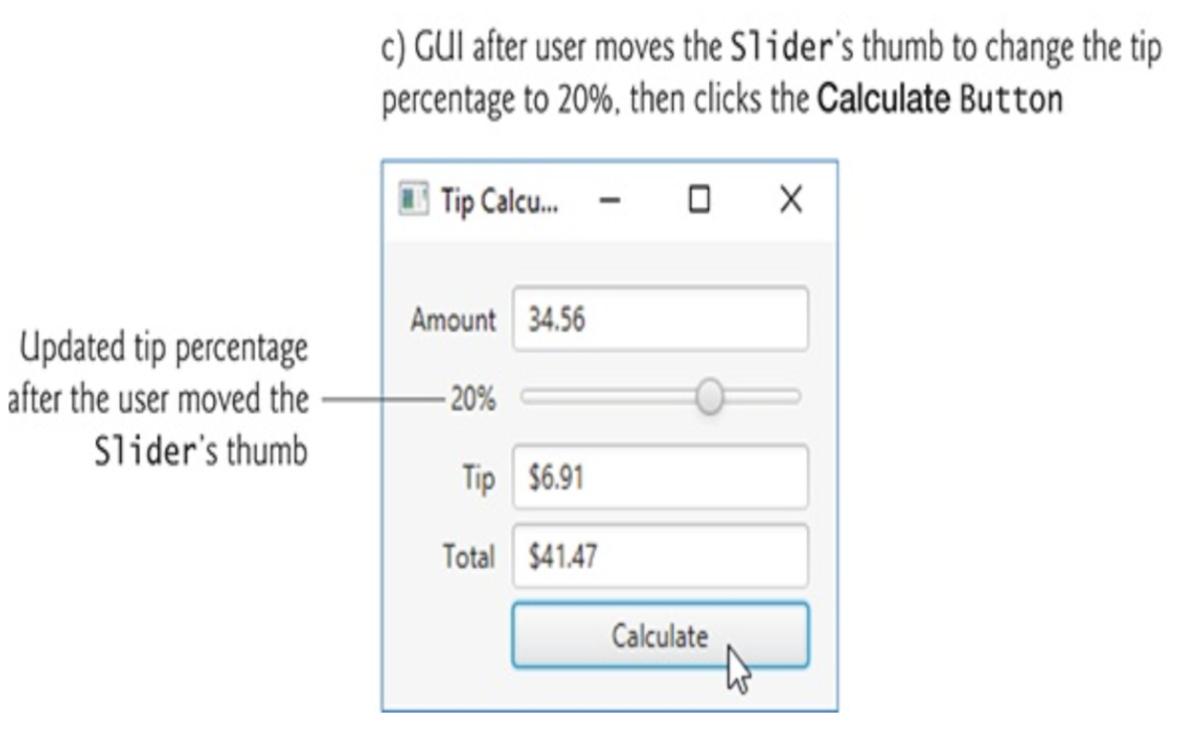
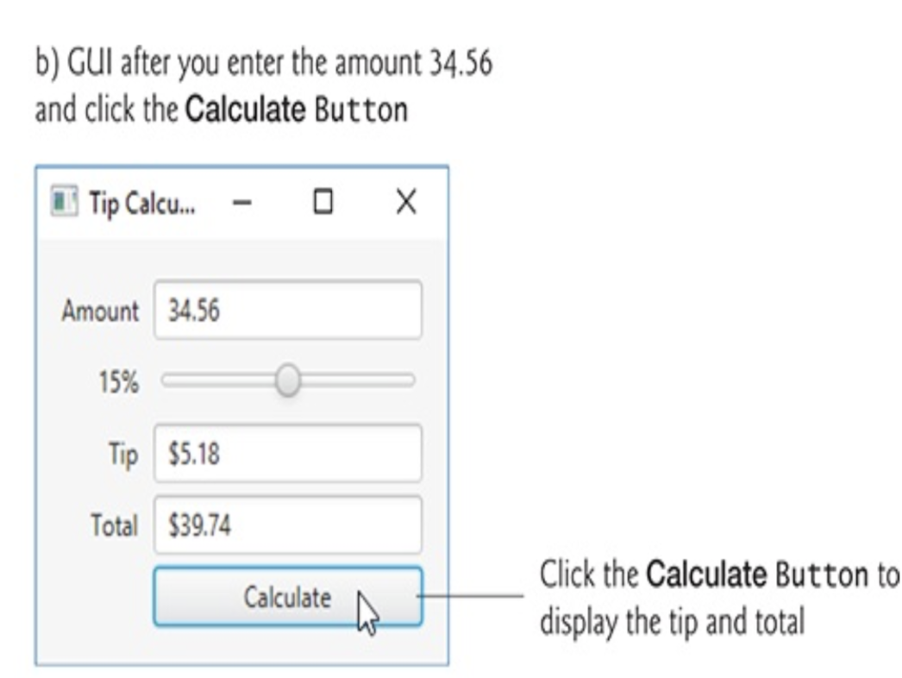

Slide 14
12.4 Tip Calculator App— Introduction to Event Handling(Cont.)
Class Application
JavaFX app is a subclass of Application (package javafx.application).
When the subclass’s main method is called:
1.Method main calls class Application’s static launch method to begin executing the app.
2.The launch method, in turn, causes the JavaFX runtime to call its init method, start method, and stop method.
3. The Application subclass’s start method creates the GUI, attaches it to a Scene and places it on the Stage that start receives as an argument.
TestStage.java

Slide 15
12.4 Tip Calculator App— Introduction to Event Handling(Cont.)
GridPane
A GridPane (package javafx.scene.layout) arranges JavaFX components into columns and rows in a rectangular grid.
Each cell can be empty or can hold one or more JavaFX components
Each component in a GridPane can span multiple columns or rows
Scene Builder creates the GridPane with two columns and three rows by default.
https://docs.oracle.com/javase/8/javafx/api/javafx/scene/layout/GridPane.html

Slide 16
12.4 Tip Calculator App— Introduction to Event Handling(Cont.)
TextField
A TextField (package javafx.scene.control) can accept text input from the user or display text.
Slider
A Slider (package javafx.scene.control) represents a value in the range 0.0–100.0 by default and allows the user to select a number in that range by moving the Slider’s thumb.
Button
A Button(package javafx.scene.control) allows the user to initiate an action

Slide 17
12.4 Tip Calculator App— Introduction to Event Handling(Cont.)
Formatting Numbers as Locale-Specific Currency and Percentage Strings
class NumberFormat (package java.text)
private static final NumberFormat currency =
NumberFormat.getCurrencyInstance();
private static final NumberFormat percent =
NumberFormat.getPercentInstance();
NumberFormatDemo02.java

Slide 18
12.4 Tip Calculator App— Introduction to Event Handling(Cont.)
Event Handling
When the user interacts with a GUI component, the interaction—known as an event— drives the program to perform a task.
The code that performs a task in response to an event is called an event handler, and the process of responding to events is known as event handling.

Slide 19
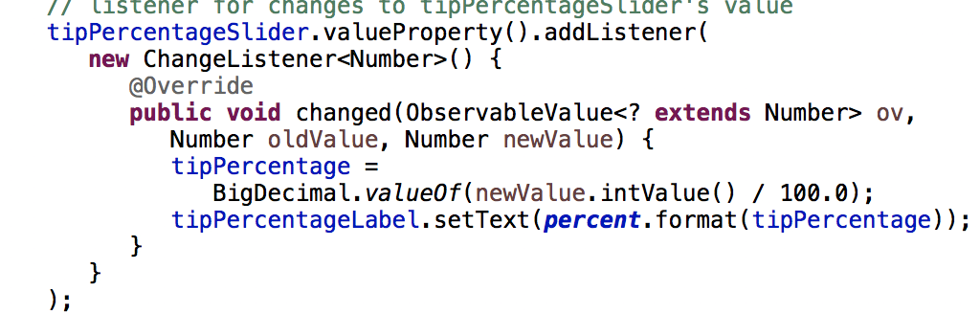
12.4 Tip Calculator App— Introduction to Event Handling(Cont.)
Before an app can respond to an event for a particular control, you must:
Define an event handler that implements an appropriate interface— known as an event-listener interface.
Indicate that an object of that class should be notified when the event occurs—known as registering the event handler.

Slide 20
12.4 Tip Calculator App— Introduction to Event Handling(Cont.)
Using an Anonymous Inner Class for Event Handling
declares the event listener’s class,
creates an object of that class and
registers it as the listener for changes to the tipPercentageSlider’s value.
An anonymous inner class can access its top-level class’s instance variables, static variables and methods
an anonymous inner class can access only the final or effectively final (Java SE 8,) local variables declared in the enclosing method’s body.
A variable or parameter whose value is never changed after it is initialized is effectively final.

Slide 21
12.4 Tip Calculator App— Introduction to Event Handling(Cont.)
Using a Lambda to Implement the ChangeListener
We’ll show how to implement such interfaces with lambdas in Chapter 17.

Slide 22
Model-View-Controller(MVC) Architecture
separates an app’s data (contained in the model) from the app’s GUI (the view) and the app’s processing logic (the controller).

Slide 23
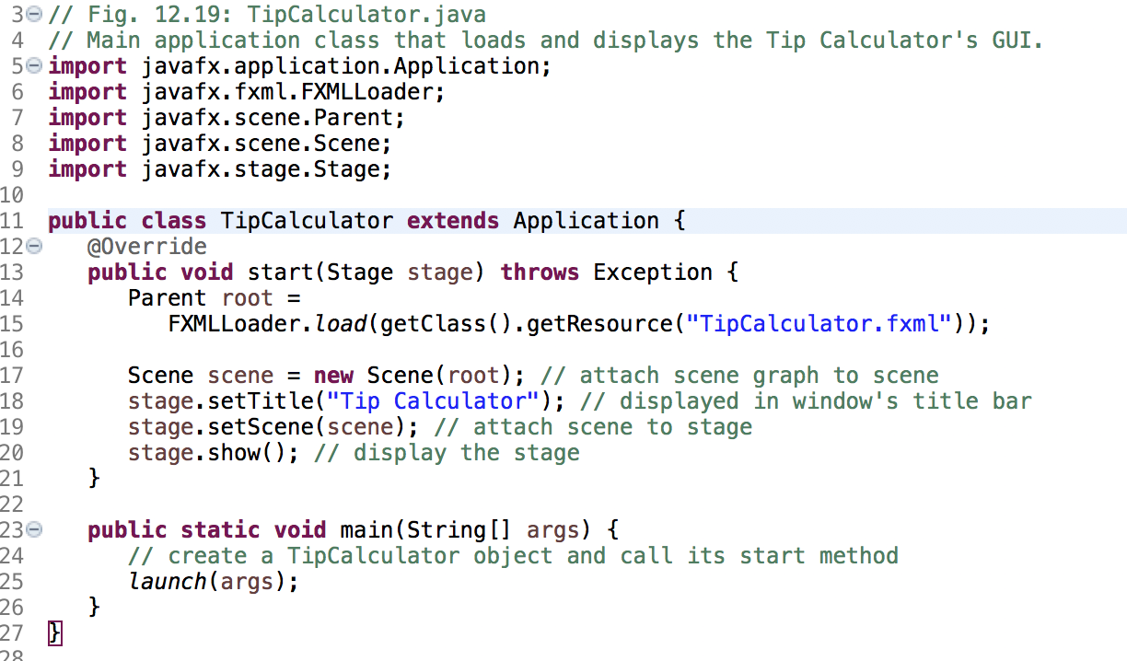

Slide 24
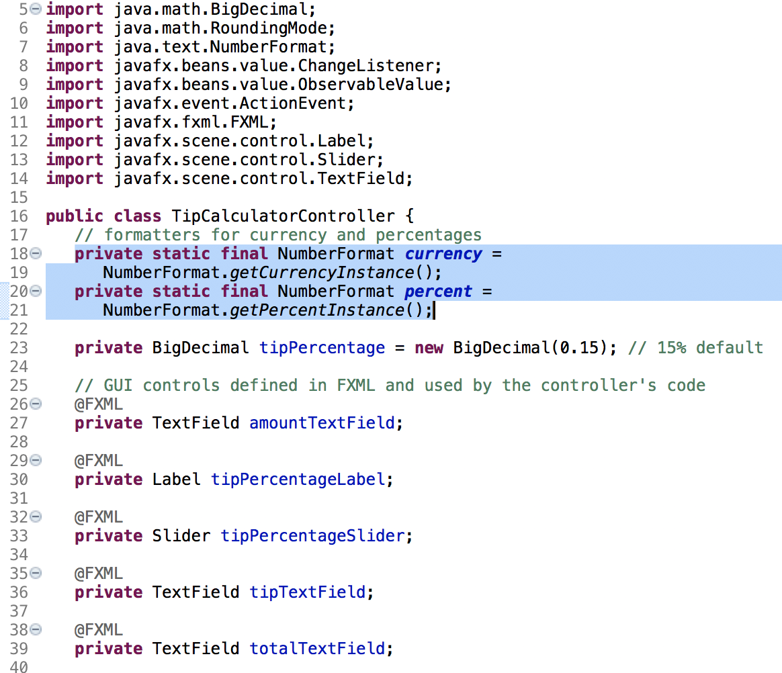

Slide 25
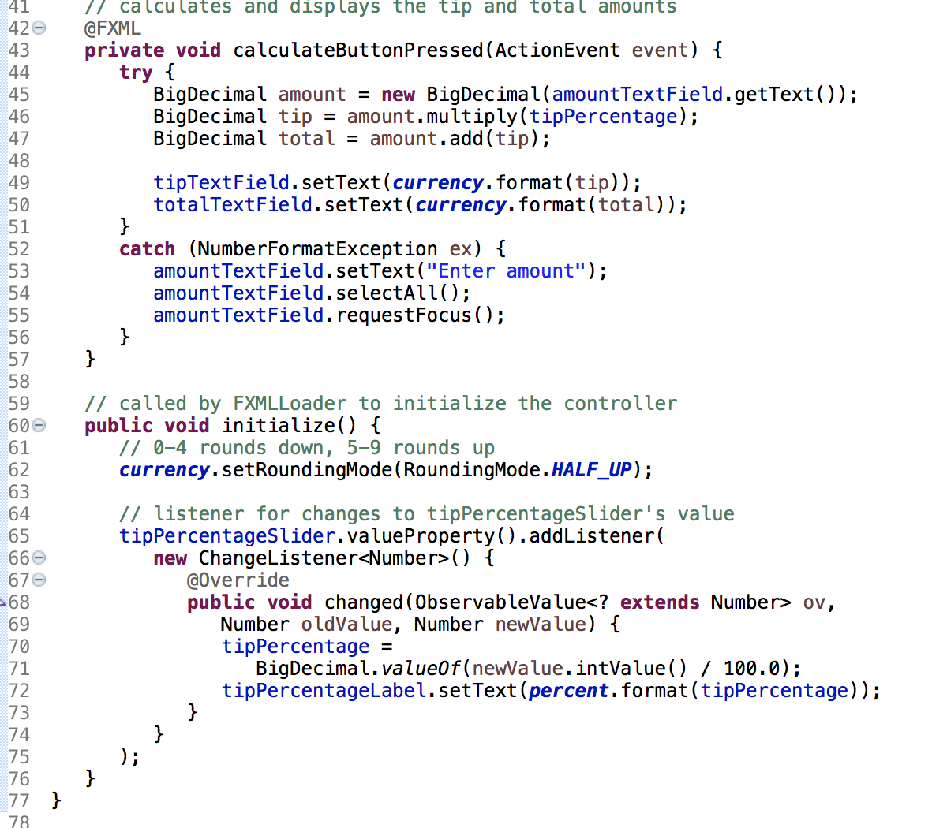

Slide 26
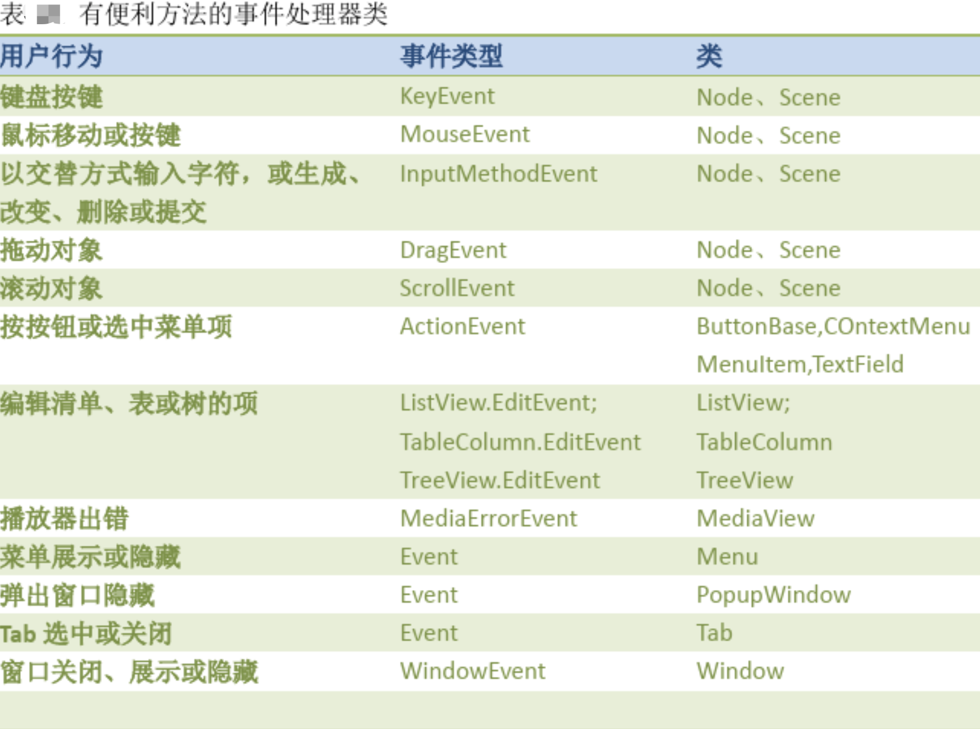
Event Handling
EventHandleTest.java EventHandleMenu.java

Slide 27
Event Handling
1. Event Source
Button btn = new Button();
2. Event Handler
Implement EventHandler
3. Register
setOnAction
addEventHandler

